Slide 1
the Anglophone Crisis in Cameroon AND THE RESPONSE OF THE PCC
By
Rev Mokoko Mbue T

Slide 2
Outline
The Historical Roots of the Anglophone Problem
The Evolution of the Anglophone Problem
Recent Developments
The Role of the PCC in the Anglophone Crisis
Government’s Reaction

Slide 3
The Historical Roots of the Anglophone Problem
12th July 1884 – Cameroon was colonized by Germany
1914 – WWI broke out and Britain and France attack Germany in Cameroon
1917 – Germany was defeated in Cameroon and through a bilateral arrangement Cameroon was partitioned between Britain and France.

Slide 4
The Historical Roots of the Anglophone Problem
This arrangement was confirmed by the League of nations in 1919
1917 – 1961 Cameroon was governed as two separate colonial entities under two different colonial masters with two different political and social cultures

Slide 5
The Historical Roots of the Anglophone Problem (con’d)
- 1st January 1960 – Independence of The Republic of Cameroon
- 11th February 1961 – Plebiscite for British Northern and Southern Cameroons

Slide 6
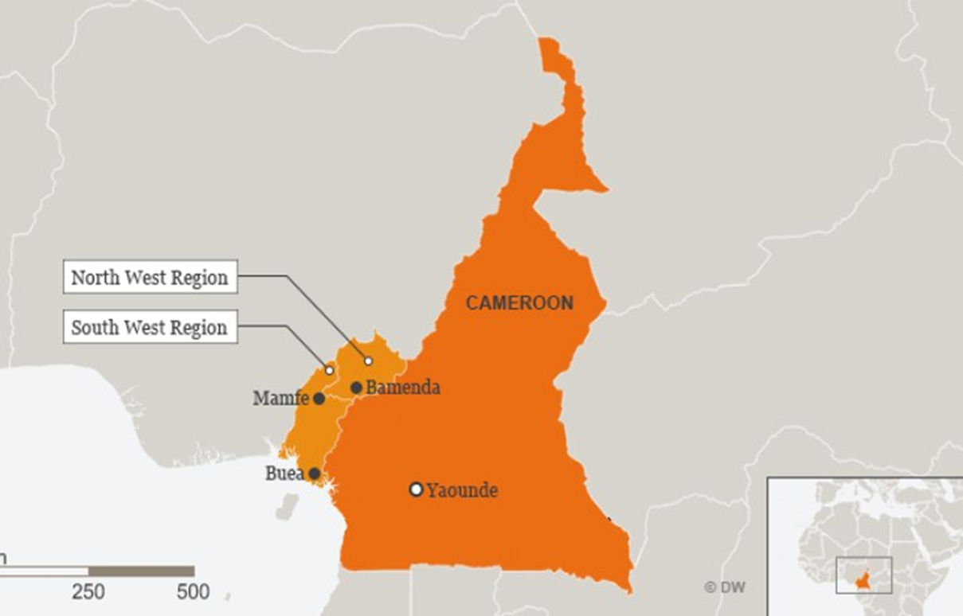
The Historical Roots of the Anglophone Problem (con’d)

Slide 7
The Historical Roots of the Anglophone Problem (con’d)
Foumban Conference (July 17th – 21st1961)
Some resolutions of the Foumban/ Yaounde Conference
i. The name of the new nation was the Federal Republic of Cameroon
ii. Two independent educational and judicial systems to be followed
iii. Two languages of equal status
iv. Two regional assemblies (one for East Cameroon and another for West Cameroon), one house of Chiefs for Southern Cameroon and one national assembly
v. A president and Prime Minister to lead the young nation

Slide 8
The Evolution of the Anglophone Problem
- The 1966 political “coup” and the formation of the CNU Party
- The 1972 Referendum and change of name from the Federal Republic of Cameroon to the United Republic of Cameroon
- The 1984 change of name from the United Republic of Cameroon to the Republic of Cameroon and its political implications

Slide 9
The Evolution of the Anglophone Problem
- The rebirth of multipartism and its consequences on Anglophones
- The GCE Board Crisis
- Demands for an Anglo-Saxon university
- The creation of Southern Cameroon National Congress (SCNC) – 1995 and other organisations

Slide 10
The Evolution of the Anglophone Problem (Cont’d)
- Persistent complaints about the marginalization of the Anglophones:
i. The exclusive use of French for appointments and other public functions
ii. The stagnation and emasculation of developmental initiatives in Anglophone Cameroon (the closure of the marketing Board, POWERCAM in Yoke, the Tiko, Bali and Bafut airstrips etc)
iii. Second-class treatment of Anglophones in appointments etc

Slide 11
The Evolution of the Anglophone Problem (Cont’d)
- All Anglophone Conference (AAC) I and II in 1993 and 1994 respectively
- 2015 - Lawyers petition the government over the non-respect of the Common Law system and the imposition of Francophone judges and civil law in courts in Anglophone Cameroon.
- October 2016 – the lawyers associations go on a sit-down strike

Slide 12
Recent Developments
- November 2016 – teachers’ associations join the strike action in protest against the non-respect of the Anglo-Saxon system of education and the posting of teachers with no knowledge of English to teach subjects other than French in Anglophone schools
6th December 2016 – creation of the Cameroon Civil Society Consortium with Barrister Agbor Balla as President and the demand for a return to the Federal System of government
- Calls for Ghost towns from 7th January 2017 by the Consortium

Slide 13
Recent Developments
- January 12^{th –} 13th, 2017 – government through the Ghogomu Adhoc Committee engages dialogue with the teachers’ and lawyers’ associations in Bamenda
- February 2017 – internet cut, the arrest of the leaders of the Consortium, transfer of the leadership of the Consortium to the Diaspora and the radicalization of the crisis
- 22nd September 2017 – mass protests across Anglophone Cameroon

Slide 14
Recent Developments
- 1st October 2017 – Protests in request for independence of the Republic of Ambazonia
- October 2017 - Full armed conflict
- January 2018 – the arrest of Nera 10 – Sessekou Ayuk Tabe and Co in Nigeria
- A fractured Diaspora

Slide 15
The role of the PCC in the Anglophone Crisis
- The PCC and the GCE Stalemate
- The PCC’s stance on the creation of an Anglo-Saxon University
The PCC and multiparty politics
See: Cry Justice: The Church in a Changing Cameroon edited by Nyansako – ni - Nku
- November 2016, the Moderator of the PCC, together with the Bishop of the Arch Diocess of Bamenda made efforts to broker peace between the trade unionists and the governor of the North West Region.
- The PCC, in different communiqués to the government has articulated its stance on the issue and urged government to initiate dialogue.

Slide 16
The role of the PCC in the Anglophone Crisis (cont’d
1st Communiqué was the Moderator’s usual New Year Message to the Presbyterians on the 1st of January 2017 (at the early stages of the conflict). It was titled “Pastoral Letter: Our God is a God of History” in this letter the Moderator wrote:
One thing which is clear is that God remains the Lord of our history and calls us to repentance so that our country can experience the reason why He made us Cameroonians. Those who insist on the uneasy coexistence should be able to answer; how can there be co-existence without mutuality and trust? Those who call for federalism must also be reminded that even in the new fragments of the federation, there would be minority problems.

Slide 17
The role of the PCC in the Anglophone Crisis (cont’d
Those who call for secession must be reminded historically that there cannot be any secession without bloodshed like the cases of Yugoslavia, South Sudan, and Eritea, just to mention a few. Those who call for decentralization must answer; why for all this while the so-called devolution of competences to local councils have dragged on or why should institutions in one council pay their taxes to another council area? So, you see, the problem of Cameroon has been one of peace without justice, Justice without truth and bad faith in governance. This is the time for truth.

Slide 18
The role of the PCC in the Anglophone Crisis (cont’d
The Moderator articulated the stance of the PCC as follows:
1. We recognize the efforts of the Prime Minister of the Republic of Cameroon in creating adhoc committees to see into the issues tabled by Teachers Trade Union and Common Law Lawyers. While this is a starting point, may all the preliminary objections be cleared comprehensively in order for these committees to function fully. Those who are called to these committees must show a high sense of patriotism, truth, good faith and humaneness. We call for dialogue, peace and understanding so that we can identify the points of weaknesses, the areas of our common strengths and how we can rekindle a spirit of trust, a spirit of tolerance and a spirit of love.

Slide 19
The role of the PCC in the Anglophone Crisis (cont’d
2. We condemn acts of violence perpetuated by the Forces of Law and Order and some civil authorities. Such acts should be investigated and the officers involved brought to book. In the same light, anyone who is in detention should be proven guilty of violence before detention; otherwise it is unlawful to keep people behind bars for an indeterminate period of time.
3. All proposals for reconciliation should have both short and long term considerations.

Slide 20
The role of the PCC in the Anglophone Crisis (cont’d
4. The government of Cameroon, the Teachers’ Trade Unions and Common Law Lawyers should do everything possible to see into the commencement of schools and private practice of the Common-Law Lawyers.
5. We volunteer our services and our facilities as a Church that will lead to genuine reconciliation and long lasting peace; hoping that this will contribute to the healing of our Land.

Slide 21
The role of the PCC in the Anglophone Crisis (cont’d
2nd Communiqué: On the 27th of January 2017 the Synod Executive Committee sent out another letter on the Anglophone Crisis – a letter that was endorsed by the Board of Trustees. In the letter, EXCO stated:
We thankfully acknowledge the creation of the commission on Bilingualism and Multi-culturalism as a vehicle to bring about national and social cohesion and to create a climate of mutual understanding and patriotism among Cameroonians.

Slide 22
The role of the PCC in the Anglophone Crisis (cont’d
To further concretize this move as a Church, we prayerfully call on all the stakeholders to take all the necessary measures to ensure that schools resume effectively and that the ghost town be called off as a matter of urgency.
In the same vein, we earnestly propose that Amnesty be granted to all those who are detained because of their political ideologies, and those detained because of crimes committed within this period, should be detained and tried in the regions where they were arrested, so that their rights to be cared for by family members and friends would be guaranteed. This will be a commendable sign of goodwill from the state of Cameroon. We equally plead that further arrest should be discontinued. We also humbly crave that internet be reinstated wherever it has been embargoed to restore trust and our emerging economy.

Slide 23
The role of the PCC in the Anglophone Crisis (cont’d
It would be of most importance if the state of Cameroon would comply with the decisions arrived at during the last meeting with the Teacher’s Trade Union Leaders to enable effective resumption of schools.
We call on all PCC Christians nationwide to go on their knees and pray for a peaceful and lasting resolution of this situation that has invaded and tarnished the social fabric of our society.

Slide 24
The role of the PCC in the Anglophone Crisis (cont’d
The third communiqué was jointly signed by the Moderator of the PCC, the President of the Cameroon Baptist Convention and the 5 Roman Catholic Bishops of the Bamenda Ecclesiastical Province on 9th February 2017. They stated:
We think that the non-resumption of schools in the North West and South West Regions is a pointer to more profound socio-political issues that need to be identified and addressed sooner than later, it is important to note that the oppressive, intimidating and unbearable attitude of some members of civil administration, such as the attitude of the Governor of the South West Region, has further hardened the hearts of the common people.

Slide 25
The role of the PCC in the Anglophone Crisis (cont’d
Furthermore, the inhuman treatment, torture, rampant arrests and the complete shutdown of the internet and consequently of businesses and services that depend on an internet connection for a smooth functioning have aggravated the situation.
As pastors, preachers of the Good News and mediators of social justice and peace, we earnestly appeal to the Government and the people of Cameroon for a change of heart and to engage in a meaningful and constructive dialogue. We further call on our Christians and people of good will to pray fervently for wisdom and understanding to seek true and lasting solutions that will guarantee justice and peace.

Slide 26
The role of the PCC in the Anglophone Crisis (cont’d)
Synod Messages (2016)
The 48thSynod of the Presbyterian Church in Cameroon dubbed Synod of Unfailing Love meeting in Bamenda at Church Centre Mankon from 20th to 21st November 2016, as concerns the Anglophone crisis, inter alia, requested the President of the Republic to:
as soon as possible, engage in dialogue with the Trade Unionists and Common Law lawyers whose plight is gaining steam and attracting solidarity from other quarters and pray for the cessation of any form of violence on peaceful protesters who only want to be heard.

Slide 27
The role of the PCC in the Anglophone Crisis (cont’d)
And to the governor of the North West Region
Delegates expressed concern on the recent brutalization of Common Law Lawyers and pray you to restrain any use of force and bring to book overzealous officers who have overstepped their bounds. Delegates encourage you to pursue the path of dialogue you have begun and commit themselves to pray for peace and justice.

Slide 28
The role of the PCC in the Anglophone Crisis (cont’d
Sermon for the Opening of the 2016 Synod
The Moderator of the PCC, Rt. Rev Fonki Samuel, in a sermon preached on the 20th of November at PCC Ntamulung on the occasion of the opening of the 48th Synod, concerning the Anglophone problem said:
It is only a fool who keeps sleeping in his house when that house is on fire. Recent happenings in the Anglohpone part of our country and the silence of the powers that be are very disturbing. The uniqueness of our country in Africa and in the world is something to be upheld with pride. Our bilingualism is not a curse but a blessing, our bi-cultural identity is not a curse but a golden touch, our bi-jural system is not a curse but a jewel that places Cameroon and Cameroonians in front of the whole world. Should we hold these blessings with fragile and careless hands? Should we toy with these?

Slide 29
The role of the PCC in the Anglophone Crisis (cont’d
To blatantly and officially abuse the Constitution of our country that protects this unique bilingual and cultural identity of our country is not a thing to be taken for granted or ignored by those who have this country at heart. To enter into an international protocol and produce a document that ignores one of the official languages of the country is not an error to be made because that alienates a people and creates tension and agitation in them.
To negotiate for what is the Constitutional right of a people is not only dehumanizing, but bad faith. When what is the Constitutional right of a people applies to “A” it should immediately and unconditionally apply to “B.”

Slide 30
The role of the PCC in the Anglophone Crisis (cont’d
That is objectivity, transparency and fair-play that have been trampled underfoot to the pain, anger and frustration of a people.
It has been too long that the Cameroon Common Law Lawyers and the Stakeholders of Anglo Saxon education have been crying that there is a systemic and endemic destruction of their cultural identity. Should they keep crying and no one to listen to and console them? Should they keep striking and boycotting? Can there be emergence in such an unhealthy and unfriendly situation? Should they keep leaving in a hopeless and helpless situation? Are they a fatherless people?
It is true that if the powers that be turn to be insensitive to the sentiments and the genuine voices of her people’s cry, then the unexpected can happen.

Slide 31
The role of the PCC in the Anglophone Crisis (cont’d
Synod Message (2018)
The 49th Synod of the Presbyterian Church in Cameroon, meeting in Bafoussam from the 20th to the 21st of January 2019, under the theme “Synod of Endurance” in its letter to the President of the Republic made the following remarks:
Our nation, over the last two years, has gone through its most challenging crisis since independence – a crisis which has challenged the very essence of our existence as a nation.
The two Anglophone regions till date are buried in a senseless war which pits one Cameroonian against another, and which has consumed the lives of numerous citizens, especially the youth who are the backbone of development.
This has led to the collapse of traditional authority and social cohesion that has seriously affected the economy and led to the displacement of thousands of civilians both internally and externally.
.

Slide 32
The role of the PCC in the Anglophone Crisis (cont’d
Innocent civilians are suffering from arbitrary arrest, extortion, intimidation, kidnappings, torture and even murder. Caught in this vicious web, your citizens, are lamenting.
In these upheavals, the PCC has not been spared. Church houses and schools and other properties have been burnt down, houses of worship have been desecrated, Pastors, teachers and their families have been attacked and molested, and many Christians have been maimed and displaced. The Church which has the duty to pray for the nation and which over the years has been a partner in development with the government feels targeted.
.

Slide 33
The role of the PCC in the Anglophone Crisis (cont’d
Synod reminds Your Excellency that the position of the PCC vis-à-vis the current crisis, as evidenced by the numerous communiqués from the Moderator and Synod Committee Executive, has not changed – it remains the call for inclusive and constructive dialogue.
Synod recommends the following:
That Your Excellency, after all the broad-based consultations, should engage in inclusive dialogue as a matter of urgency
That Your Excellency should accelerate the legal procedure of all who have been arrested as a result of the current crisis.
That government should facilitate the convening of the Anglophone General Conference by religious leaders to form the groundwork for dialogue.

Slide 34
The role of the PCC in the Anglophone Crisis (cont’d)
- The PCC has called for two sessions of fasting and prayer for all Christians of the PCC
- The PCC has called for general fundraising in the congregations to support the refugees. Congregations are donating foodstuff and clothing for the persons in the forests and reaching out to some of them. But the enormity of the need is daunting.
- PCC congregations have raised funds and assisted the teachers who have gone for months without salary
- The PCC championed the drafting of the position of CEPCA on the Anglophone Crisis

Slide 35
The role of the PCC in the Anglophone Crisis (cont’d)
- The PCC has been part of the initiative of the Anglophone General Conference (AGC) alongside Cardinal Tumi, the Baptists and the Imams of Buea and Bamenda to form a platform for dialogue amongst Anglophones to prepare for a genuine national dialogue
- The PCC is part of an ecclesiastic initiative of CEPCA, the Episcopal Conference, the Orthodox Church and the Islamic Grand Council to push national and international stakeholders for the resolution of the Anglophone Crisis.
The Moderator was a delegate at the famous Grand National Dialogue

Slide 36
The role of the PCC in the Anglophone Crisis (cont’d)
Support to IDPs
Support to IDPs has been local and Central.
Local congregations do fund-raising, and where possible are assisted by partners, to carter for IDPs in their locality.
Meanwhile, the Central Church, through local and partner funding, reaches out to IDPs through Presbyteries and congregations
Support was given to all Presbyteries in 2018 when the crisis hit its peak and displacement rose to a record-breaking figure in Cameroon. This aid touched the lives of over 30,000 displaced and host families throughout the country.
Since 2018, the PCC gives semester humanitarian assistance to IDPs. Support is sent to Presbyteries either in cash for on-the-spot purchases or in kind for direct distribution to IDPs. Over 90,000 IDPs and host families have received relief items.

Slide 37
The role of the PCC in the Anglophone Crisis (cont’d)
Through Direct Partners in Germany10,000 IDPs in Meta, Donga Mantung, Ngie, Ndop, Bui, Menchum, Meme North, Meme South, Mamfe, Akwaya, Dikome, Kumba, Bali, Bafut, Mezam, Fako North and Fako South have received food and non-food items to relieve their situation during a period.
50 displaced Pastors were assisted in their host Congregations and communities.
In partnership with the Methodist Church in Britain, the Moderator visited and gave support to over 1,000 Refugees in the Calabar, Ikang and Ogoja camps.

Slide 38
Government’s reaction
- Subtle threats to Church leaders
- Siege of the Synod Office / accusations against Rt. Rev Awasom
- Remanding and questioning of Synod Clerk Rev Nyansakoni-Nku
- Lawsuit against the Rt. Rev Fonki Samuel and other Church leaders in April 2017

Slide 39
Conclusion
The Church has a role to play in the public arena. For the Church to be the salt of the earth its impact must be felt beyond the walls of the Church as it strives to bring practical responses to the practical needs of the people.
The Church does not engage in partisan politics, but the Church is not neutral in political issues. The Church must always ask the question: “What is God calling us to do/say at this point in time”
Action informed by fervent prayer is always powerful!

Slide 40
Thanks for your kind attention

