Slide 1
PROJECT TITLE: BACK TO SCHOOL “Education can not wait”
ORGANISATION: PROVIDENCE ACTION
Project lead and founder; Nformi Melvis Nyaah

Slide 2
BACKGROUND
It all started with the Anglophone crises in October 2016
In November 2017 the crisis escalated creating serious tension and fighting between government forces and the separatist fighters.
This will lead to a major security issue, with a lot of killings and burning down of schools thus leaving children without going to school.
The Anglophone crises have led to internal displacement, with children being the most affected as they have no access to education(school) in the relocated areas due to lack of finances and some have given up.

Slide 3
PROJECT SUMMARY
To mitigate the past and current effects of the Anglophone crisis on Children's education, our project seeks to help a plethora of students who still have the zeal to continue schooling despite the situation.
We are targeting young people between the ages of 10 to 20 years whose access to education in NW and SW regions has been hampered due to the crisis.
The Back to School project targets former students who have lost their parent(s), guardian(s), or sponsor(s) as a result of the crises. Also, we intend to sponsor young people who are internally displaced and still desire to return to school

Slide 4
PROJECT GOAL
This Project entails the continuous sponsorship, follow-up, and mentorship of about 10 -30 promising secondary school dropouts or internally displaced children as a result of the Anglophone crises.
This project will reduce the prospect of increased criminal actions, child marriage, and early and unwanted pregnancies among young school dropouts or IDPs in our target community.
The sustainability of this initiative will ensure the development of young leaders who will actively contribute to the development of Cameroon in the years ahead and become drivers of peace and lovers of education.

Slide 5
PROJECT SIGNIFICANCE
We are also concerned about the fact that Education in these regions has depreciated, and its value is not as solid as before. And even though many educational structures are trying to recuperate and restore their impact, attention needs to be directed to helping these youths take ownership of their learning journey. Our project model is centered on self-directed learning through the help of mentorship. We believe this is an ideal approach to raising peacebuilders and ethical leaders amid the political crisis, and the youths remain at the forefront of this initiative. We are particularly interested in the youth and children because they are young, vibrant, and innovative with a better ability to be agile. To that effect, this project holds the utmost importance, not just for these children but their communities and country.

Slide 6
INNOVATION /IMPACT OF THE PROJECT
Self-directed learning: founded upon assistance through one-on-one mentorship. We believe that these children need more than just going back to school.
Organize seminars and conferences centered on peacebuilding and mental health to build our beneficiaries and help them cope with the stress of the conflict.
We are also partnering with youth empowerment organizations like the Youth Inspiration and Open Dreams foundation to help provide mentors to the youths we sponsor. These students will be introduced to better opportunities within these partner organizations after completing high school. Furthermore, they will provide opportunities for capacity building, self-development, civil society engagements, and better educational opportunities.

Slide 7
INNOVATION /IMPACT OF THE PROJECT
This project is concerned with transforming the mindset of these children and helping them take ownership of their learning journey through intensive mentorship, and follow-ups.
This project will not only reduce the number of students who cannot access education, but it will also reduce the rate of criminal actions, frustration, and trauma as these students will be saved from idleness and get busy with school.
It has also been proven that many who are left to stay at home in these regions face a higher risk of being recruited by arm groups, child marriage, unwanted pregnancies, and other forms of exploitation and abuse. Therefore, the back-to-school project will go a long way to mitigate these effects.
Our ultimate goal is to give hope to those children who do not seem to have a bright intellectual future.

Slide 8
ACTIVITIES
MILESTONES | MAIN ACTIVITIES
Raise fund | Apply for grants Create a Gofundme page Design and launch a social media campaign for the project. Develop an in-person fundraising strategy (Flyer and envelop distribution)
Fetch and assemble recipients | Screen out poor performing candidates from the last batch (based on contract terms).. Team travels to the North West Region to fetch more candidates. Research: Meet with families and analyze living conditions and stories. Make final choices based on governing criteria and Inform families of selected recipients. Collect and document all necessary details and information concerning the recipient (e.g. birth certificate Contacts and addresses)

Slide 9
ACTIVITIES
MILESTONE | MAIN ACTIVITIES
Rentrée Scolaire preparations (The best part) | Decide school of choice with recipients Draft list of each recipient’s needs Finalize budget based on actual research Purchase items and pay recipients’ school fees
 | Organize a gathering with recipients and guardians Reiterate the terms and responsibilities and sign the contract
Beyond the classroom/school activities | Assign mentors to recipients (Regular check-ins) Plan check-in events

Slide 10
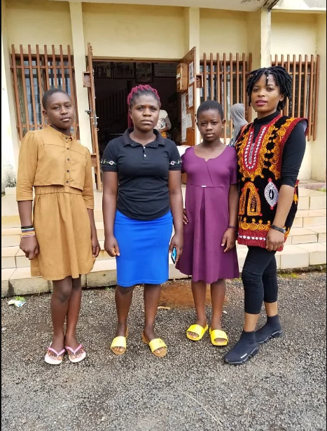
ORGANISATION TRACK RECORD Back to school project September 2021 North West region

Slide 11
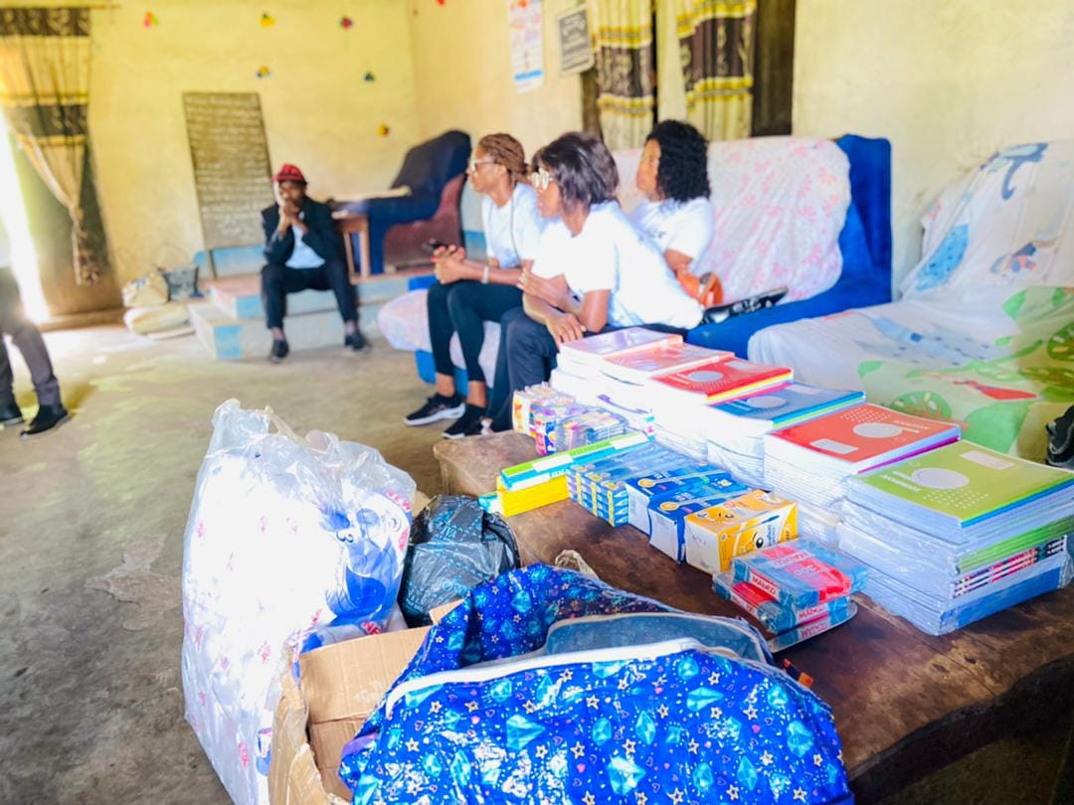
ORPHANAGE OUTREACHES St. JOSEPH FOUNDATION ORPHANAGE BUEA OUTREACH; May 6, 2022

Slide 12
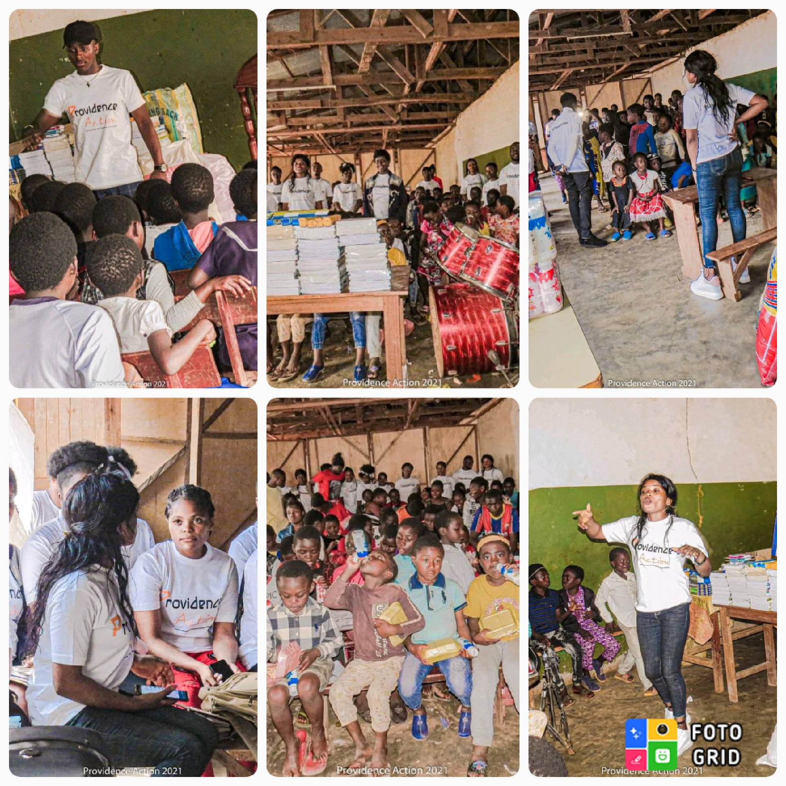
MISSPA ORPHANAGE OUTREACH mile 6 Nkwen Bamenda: June 6, 2021,

Slide 13
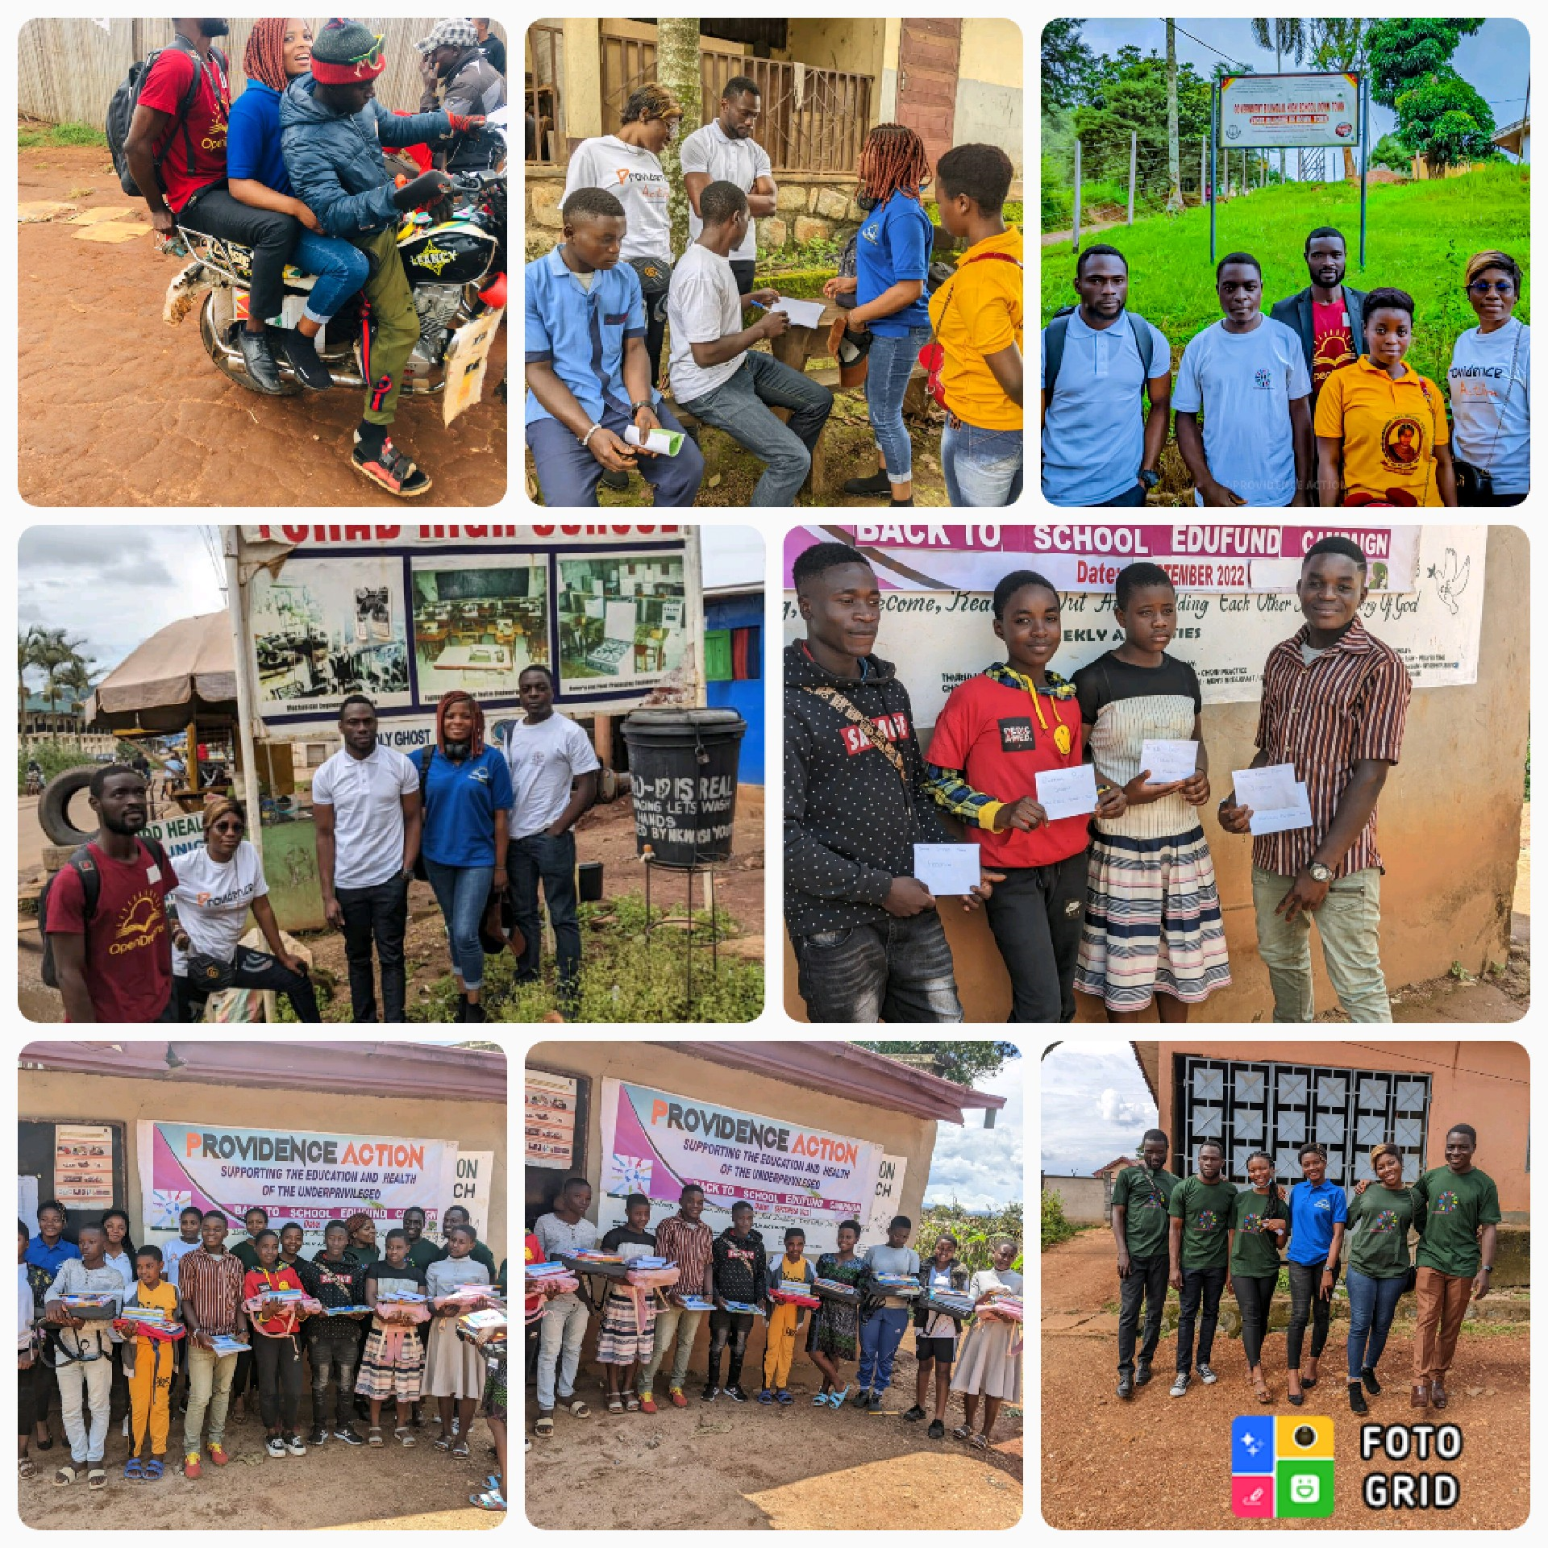
BACK TO SCHOOL PROJECT September 2022 North West

Slide 14
CHALLENGES
Our greatest challenge so far is the lack of finances to sustainably run the project.
Money remains an issue for us as we use the money to run our projects, and also we lack access to funders.
Communication is equally a challenge since our beneficiaries don’t have phones or communication tools making it challenging for us to run the project.

Slide 15
PARTNERSHIP PROJECT/COLLABORATORS
Inspire for peace. In August 2021, Inspire for Peace (a nonprofit initiative) in partnership with Providence Action, carried out a project aimed to provide school supplies like school bags, notebooks, and stationery to 20 internally displaced and economically disadvantaged primary school pupils based in Bamenda whose education were been affected by the ongoing Anglophone crisis.
Open Dreams: Upon completing the beneficiaries from high school, we will link them up with Open dreams, an NGO that helps smart students from low-income earning backgrounds access quality education.
Exponential: It is a youth-driven organization created to empower and engage young people to explore their potential through education and mentorship. They will assist us in mentoring and orientation of our beneficiaries. Also, they have previously assisted us in fetching potential recipients

Slide 16
OUR SOCIAL MEDIA HANDLES
Instagram: Providence Action
Facebook: Providence Action
Twitter: @ProvidenceAct1

Slide 17
THANK YOU
The End

